Slide 1
Physics 2 – Nov 26, 2019
P3 Challenge–
Today’s Objective: Conservation of Energy and Power

Slide 2
Agenda, Assignment
IB 2.3 Work, Energy and Power
Conservation of Energy
Power
Assignment:
Conservation of Energy Worksheet
Agenda
Types of Systems
More about Energy, Heat and Work
Conservative Forces
Conservation of Energy
Power
Efficiency

Slide 3
Types of Systems
Depending on how you draw the boundary of your system, there are three types of systems that can occur: Open, Closed and Isolated.
An open system allows both matter and energy (in the form of work and/or heat) to flow over the border of the system.
A closed system prohibits matter exchange over the border, but still allows a change in energy (heat and/or work)
An isolated system prohibits both matter and energy exchange over the border of the system.

Slide 4
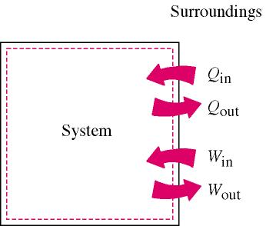
Change in energy for a system
Positive work on the system, W_{in}
Adds to the energy of a system.
Negative work on the system, W_{out}
Removes energy from a system
Positive Heat, Q_{in}
Adds to the energy of a system.
Negative Heat, Q_{out}
Removes energy from a system Overall: $∆E=W+Q$

Slide 5
Conservation of Energy
If you can identify an isolated system, then the E for the system will be zero. The result is a conservation of energy between any two states of the system over time.
Many physical situations fall under this category.
The notable exception is when there is an external force doing work on the system, usually in the form of friction.
Note: This is a conservation of energy for a given system. Contrast this to the general idea of conservation of energy in the universe.

Slide 6
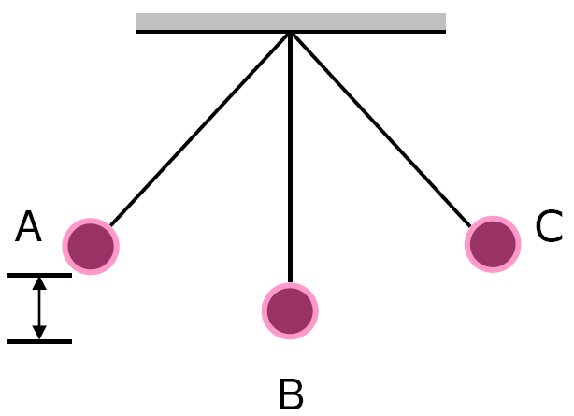
Conservative Forces
A closed loop sequence is any series of events that returns a system to the same conditions present at the beginning of the loop.
If a force does no net work during any closed loop sequence of events, then the force is conservative. If work is done, the force is nonconservative.
Consider a swinging pendulum. The work done by gravity over a complete swing is zero. It has positive work as the pendulum falls, but does an equal amount of negative work as the pendulum rises again.
Therefore, gravity is a conservative force.

Slide 7
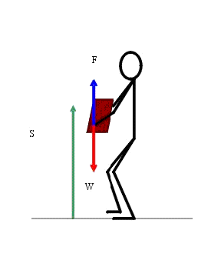
Gravitational Potential E
For every conservative force, there is a corresponding potential energy, U, defined as the opposite of the work done by the conservative force.
For the work done by gravity…
U_{g} = – W_{g} (Note IB uses the general
symbol E_{p} for all potential energies)
U_{g} = mgh

Slide 8
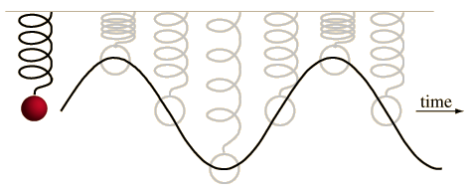
Spring Force
Consider a mass oscillating on a spring on a horizontal frictionless table.
For one complete cycle, the spring does zero work.
As the mass is being compressed, the spring does negative work.
As it moves back to equilibrium it does an equal amount of positive work.
As is becomes extended, the spring again does negative work until it turns around.
As the mass returns to equilibrium an equal amount of positive work is done.
Therefore, the spring force is a conservative force.

Slide 9
Spring Potential Energy
Because the spring force is conservative, there is a Spring Potential Energy that is equal to the opposite of the work done by the conservative force.
U_{s} = – W_{s} (Note IB uses the general symbol E_{p} for all potential energies)
U_{s} = ½ kx²

Slide 10
Problem Solving with Cons of Energy
As long as only conservative forces are present, then the total amount of energy in an isolated system will be constant.
Problem solving strategy is to inventory the types of energy present at time 1 and set their sum equal to the inventory of types of energy present at time 2.
There are three types of energy to consider: K = ½ mv² U_{g} = mgh and U_{s}= ½ kx²
The types of problems one can solve this way are similar to problems we previously solved with kinematics.
Hint: Choose a convenient point to set E_{p} = 0 to make life easy. (Ex: U_{g}= 0 at bottom of hill.)

Slide 11
Problem Solving with Cons of Energy
Ex: A 55 kg sled starting at rest slides down a virtually frictionless hill. How fast will the sled be moving when it reaches the field 1.2 m below?
Ex: What if the sled had an initial speed of 1.5 m/s?

Slide 12
When there is friction….
Friction is a nonconservative force that does negative work on a system.
The change in energy of the system E = W is equal to the work done by friction. Or
E_{k1} + E_{P1} + W_{nc} = E_{K2} + E_{P2}
W_{nc} is the work done by all nonconservative forces. (Friction is just the most common one.)
Think about a money analogy.

Slide 13
When there is friction….
Ex: A 62.9-kg downhill skier is moving with a speed of 12.9 m/s as he starts his descent from a level plateau at 123-m height to the ground below. The slope has an angle of 14.1 degrees and a coefficient of friction of 0.121. The skier coasts the entire descent without using his poles; upon reaching the bottom he continues to coast to a stop; the coefficient of friction along the level surface is 0.623. How far will he coast along the level area at the bottom of the slope? (Use energy methods)

Slide 14
Power
Power is defined as the rate at which work is done.
In mathematics this is a time derivative or $P=\frac{∆W}{∆t}$
Power is measured in Watts, (W) with 1 W = 1 J/s
An alternative formula for power is easily derived if one considers Work as a force times a change in displacement. Change in displacement over change in time we know as
velocity. So $P=\frac{∆W}{∆t}=F∙\frac{∆x}{∆t} P=F∙v=Fvcos θ$

Slide 15
Power problems
Ex: Running late to class, Jerome runs up the stairs, elevating his 102 kg body a vertical distance of 2.29 meters in a time of 1.32 seconds at a constant speed. What power did Jerome generate?
Ex: At what velocity is a car moving at the instant its engine is using 2,250 watts to exert 130 N of force on the car’s wheels?

Slide 16
Efficiency
A related idea to the power of a motor is its efficiency. In the real world, all motors that provide power that can do work, run at less than 100% efficiency. There is always some loss to nonconservative forces.
$Efficiency =\frac{Useful energy out}{Actual energy in}=\frac{Useful power out}{Actual power in}$

Slide 17
Efficiency
Ex: A certain motor uses 1300J of energy to raise a 30kg mass to a height 2.4 meters above where it started.
a. How much potential energy does the mass gain during the lift?
b. Calculate the efficiency of this motor.

Slide 18
Exit Slip - Assignment
Exit Slip- What conditions must be met to apply conservation of energy problem solving strategies for a system?
What’s Due? (Pending assignments to complete.)
Conservation of Energy Worksheet, p1-2 only.
What’s Next? (How to prepare for the next day)
Read 2.3 p78-95 about Work and Energy

